Slide 1

Birthing Registration & Check-in
Hasslefree – Safe – Digital

Slide 2





Birthgiving today
Complicated registration process
Manual appointment making
Lots of forms to fill out
Sharing the same information again and again

Slide 3
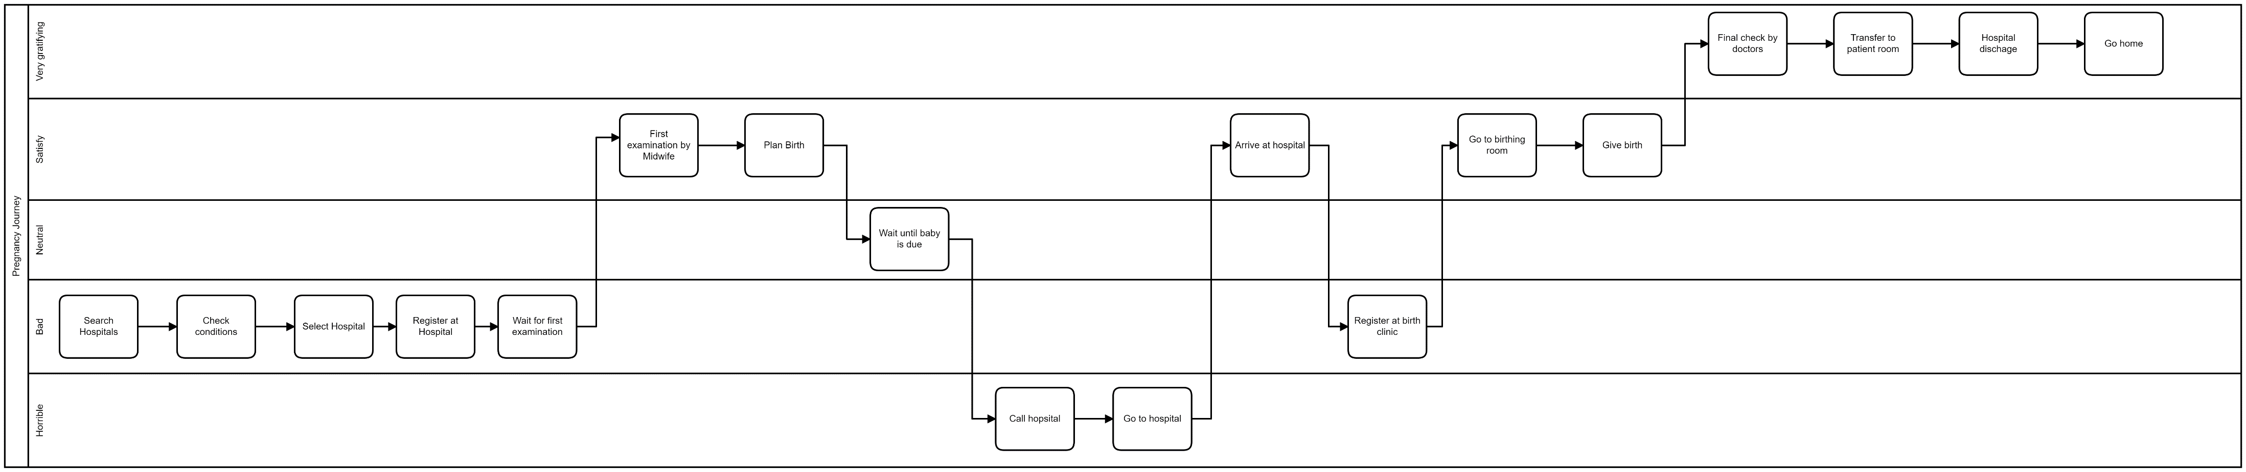
As-Is Customer Journey
Almost half of the process is experienced as bad or horrible by the customer!
Ineffecient
Stressfull
Notes:
18
7 bad/ horrible

Slide 4
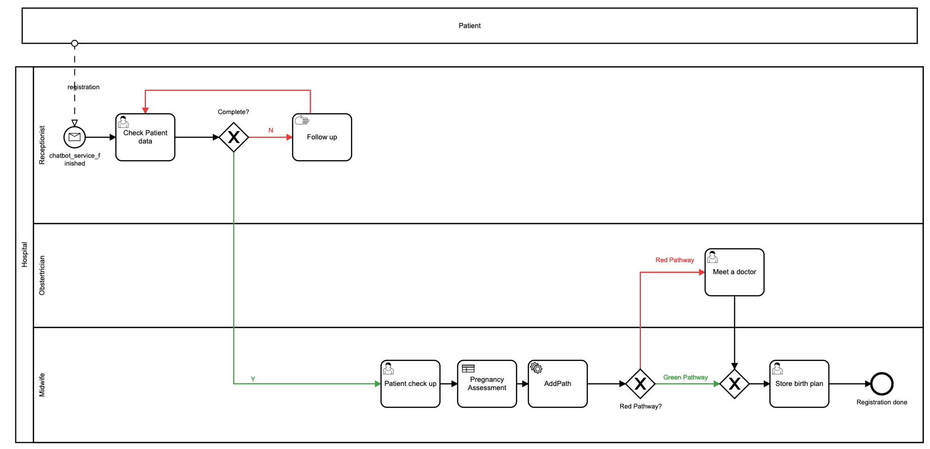


The Future

Slide 5
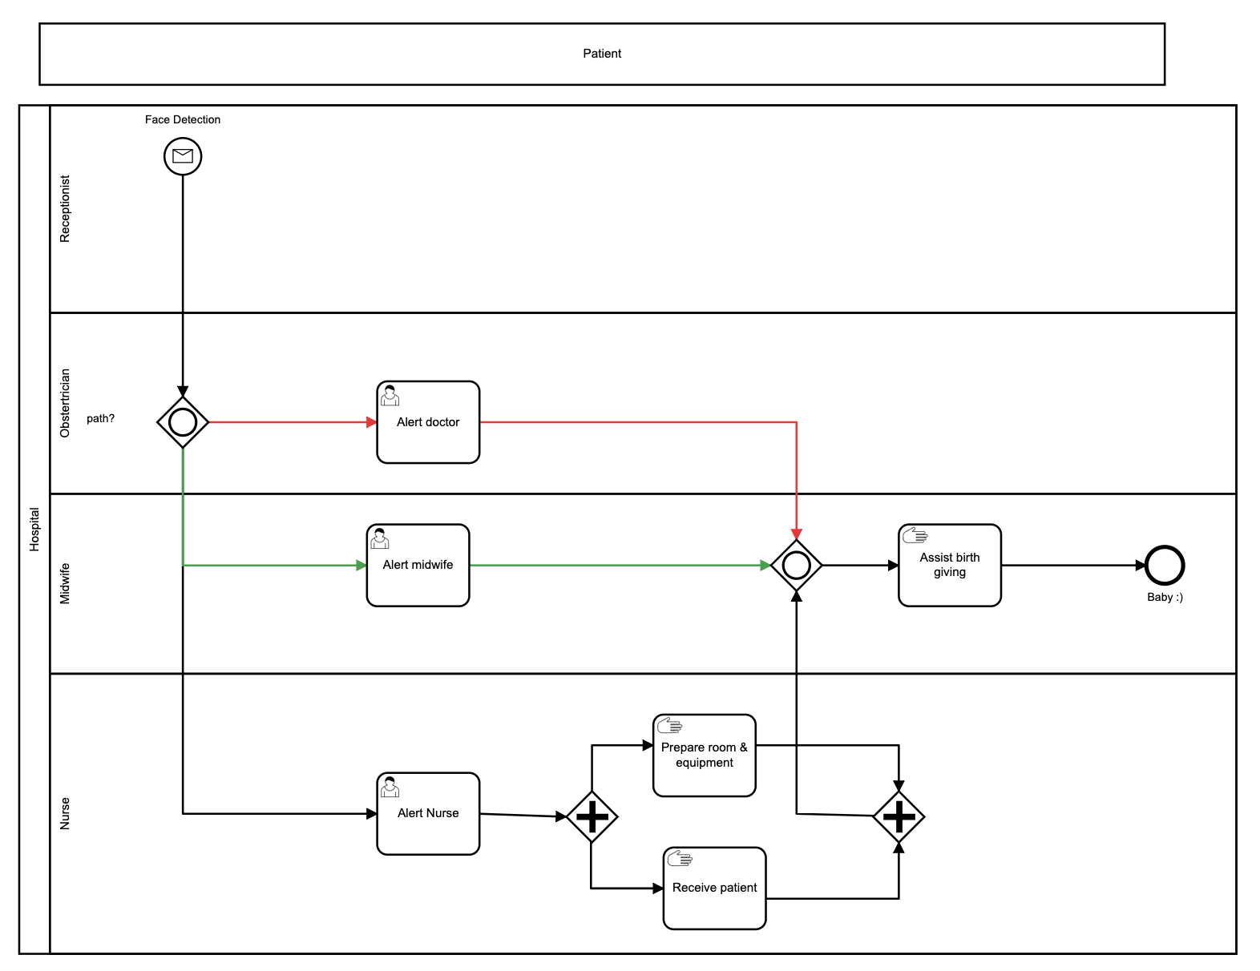
The Future
Simple and easy registration for assessment appointment via Dialogflow
Provide option for face detection service for a seamless and faster labour process
Clarify red or green pathway based on pregnancy assessment decision table
Stored pathway information enable seamless and faster labour process
Modular to-be processes for reuse

Slide 6
Live Demo

